Slide 1


Lyrics Thoughout Time
Project 1
By Adam Krvaitz

Slide 2
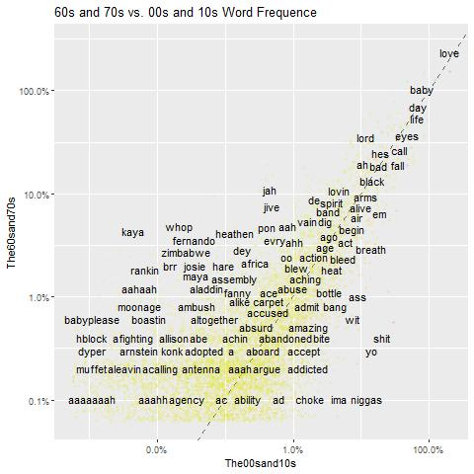
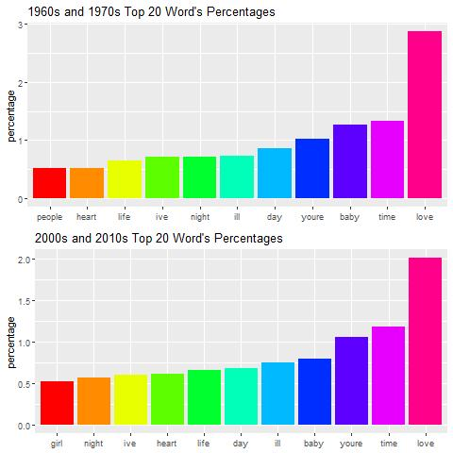
Question 1: Are the songs from the 60s and 70s more repetitive than songs from the 2000s and 2010s?
Words seem similar but, does seem to more repetive

Slide 3
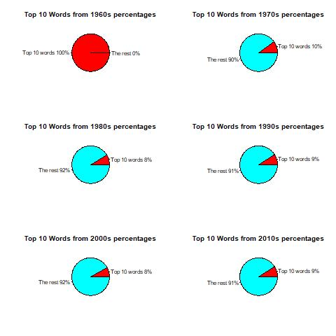
Theres something going on here
They seem to talk the top 10 words at about the same rate. If ANYTHING maybe songs are using less of there most used words, thus becoming less repetitive.

Slide 4
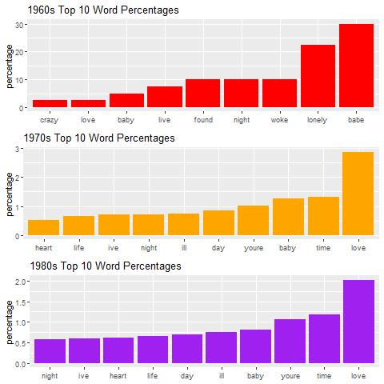
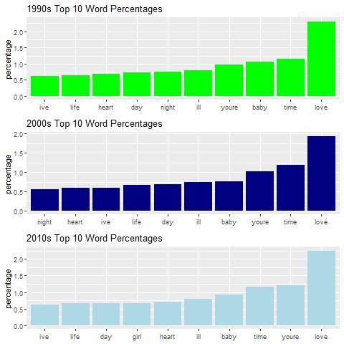
Again all about the same repetitiveness

Slide 5
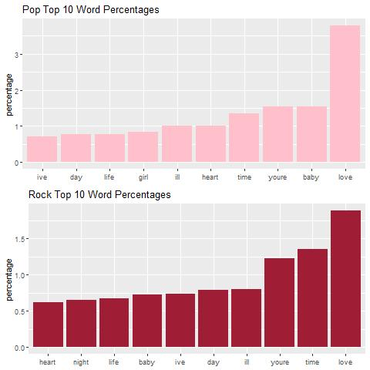
Question 2: Are different genres better mediums for different ideas?
My preferred genres of music – They seem pretty similar!

Slide 6
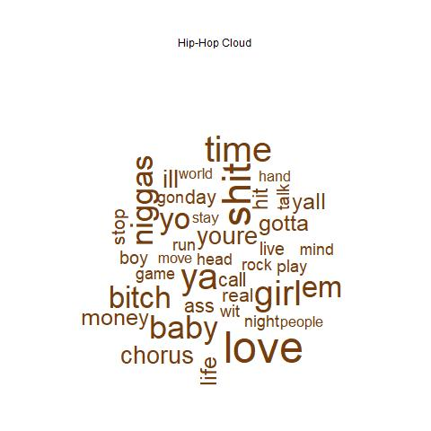
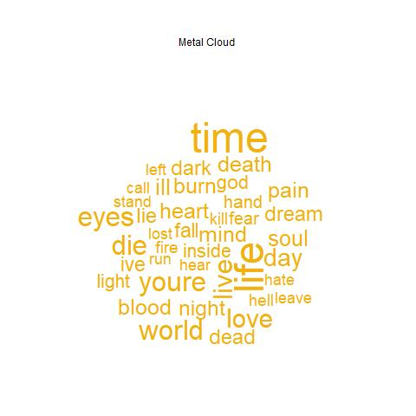
These are the 2 odd ones out compared to the rest of the of the word clouds. They talk less about love compared to the other genres. They also talk have different subjects in that they talk about to.

Slide 7
Question 3: Can you tell the genre of a song just but its repetitiveness (frequency of the words)?
Talks about love twice as much! A clear difference.

Slide 8
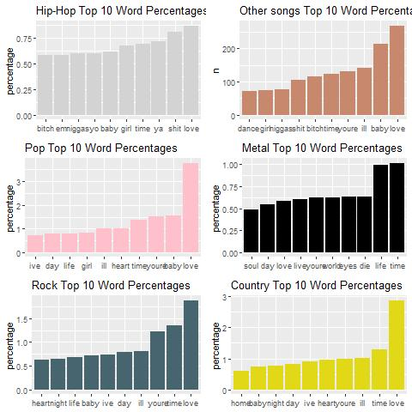
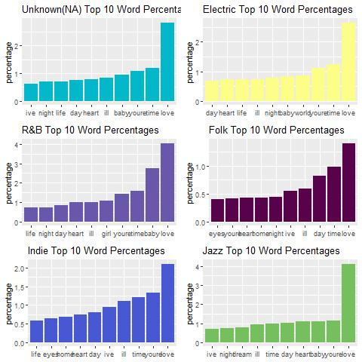

Slide 9
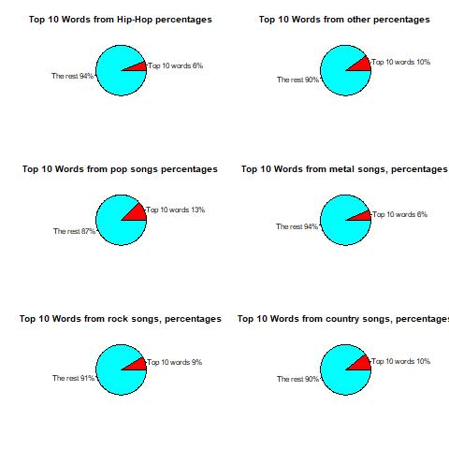
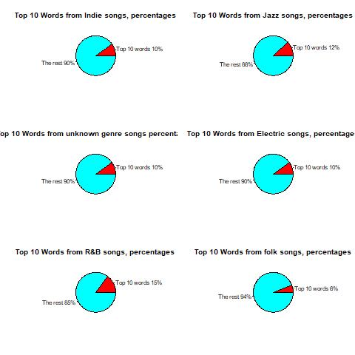
Different genres do seem to be less repetitive than others!

Slide 10
Conclusion:
Songs from the 1960s and 1970s are more repetitive than the 2000s and 2010s
Songs from the 1960s to now the 2010s are staying relatively the same repetitiveness wise. However, if there is any change at all, it seems like music is becoming less repetitive in general over time.
Rock and pop music have similar topics that they talk about, mostly talking about love even though they talk about those topics in different amounts.
Certain genres do talk about different topics (metal, and hip-hop shows us that not all genres need to talk abbout mainyly love). Thus since different genres talk about different topics there must be better genres to use to talk about certain topics since in some genres its more common to talk about those other topics( even though most genres talk about love).
Certain genres are more repetitive, that how repetitive a song of certain genre is must be a major characteristic of that genre difnes itself.

